Slide 1



K5 Tech-Talk
Automating K5 IaaS - HEAT Stacks
Graham Land
K5 OpenStack Technologist

Slide 2
About This Tech-Talk
What are you going to talk about
Orchestrating K5 Infrastructure
Heat vs. Puppet vs. Chef vs. Ansible vs. Pure Code
Why is it important/useful
IaC – Infrastructure as Code
CycleTime
Continuous Delivery Pipeline
Where to go if they want more info
Fujistu K5 Heat Documentation
OpenStack Heat online documentation*
https://allthingscloud.eu (search for stacks)

Slide 3
K5-Tech-Talk Example Stacks
https://github.com/allthingsclowd/K5-Tech-Talks

Slide 4
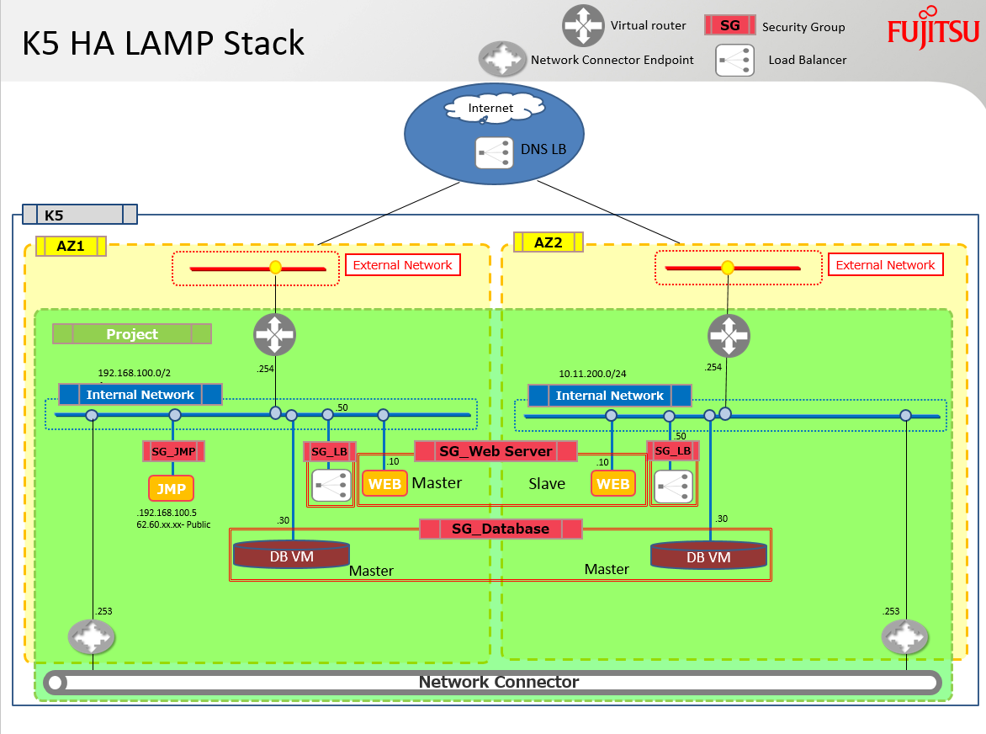

Slide 5
